Slide 1
Dyadic Behavioral Asymmetry and Linguistic Alignment: an Effort-Reward Perspective
or:
The Down Bad Index and Other Fun Things
shawn wang
shawnwang@temple.edu
github.com/fsleyes

Slide 2
Introduction
Social motivation is closely tied to a number of mental health outcomes, specifically within the field of mood disorders (Alloy et al., 2016)
In unipolar depression, anhedonia is a core symptom and is strongly linked to reduced motivation to pursue rewarding activities, such as social interactions (Gandhi et al., 2022)
In contrast, hypomanic and manic episodes in bipolar spectrum disorders (BSDs) feature increased talkativeness or pressured speech as a symptom (Crocamo et al., 2025; Nusslock et al., 2025).

Slide 3
Introduction
Within this framework, tasks such as the Effort Expenditure for Rewards Task attempt to provide an objective behavioral measure of reward motivation, showing that higher anhedonia predicts reduced reward motivation (Treadway et al., 2009).
Follow-up work links social anhedonia and depression symptoms to altered effort based decision making for monetary reward (McCarthy et al., 2015).
Similarly, evidence among those diagnosed with BSDs show heightened social reward anticipation in fMRI contexts (Alloy et al., 2016).
However, the role of social reward effort expenditure in individual with trait reward hypersensitivity is relatively less studied.

Slide 4
Introduction
Findings from studies examining conversations in dyads suggest that linguistic alignment between participants may reflect engagement with each other rather than simple rapport (Niederhoffer & Pennebaker, 2002)
This suggests that lexical alignment may represent a proxy of, or at least partially reflective of, effort that one party chooses to expend towards their conversational partner.
However, this hypothesis is yet untested, specifically within the domain of affective linguistic alignment (e.g. happiness, sadness, guilt, etc.).

Slide 5
Introduction
Furthermore, communicative effort in naturalistic texting may be treated as a domain-specific analog of effort-based decision making.
Individuals choose levels of effort to expend that are reflected through a number of behaviors (e.g. how often to initiate contact, how quickly to respond, how long messages should be, etc.) under uncertain social reward expectations.
This operationalization of effort expenditure for social reward is too, yet untested.

Slide 6
Research Question
Thus, I propose that the relationship between behavioral asymmetry and affective linguistic alignment is driven by motivated attention and effort expenditure.
Research Question:
Does the degree of dyadic linguistic alignment on affective dimensions by conversation predict dyadic behavioral asymmetry in that same conversation in a naturalistic text message corpus?

Slide 7
Hypothesis
Greater linguistic alignment within a dyad will be negatively associated with dyadic behavioral asymmetry. That is, dyads with higher alignment will show lower behavioral effort asymmetry (i.e. more equal effort across dyad), whereas dyads with lower alignment will show greater behavioral asymmetry (i.e. less equal effort across dyad).

Slide 8
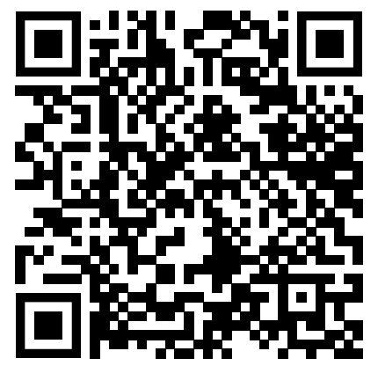
References

Slide 9
Methods:
To R!

